Slide 1
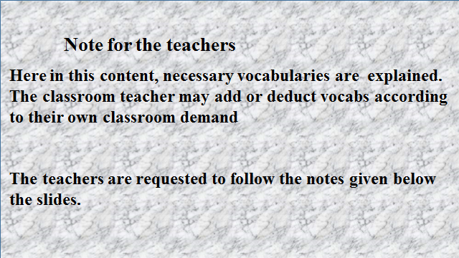

Slide 2
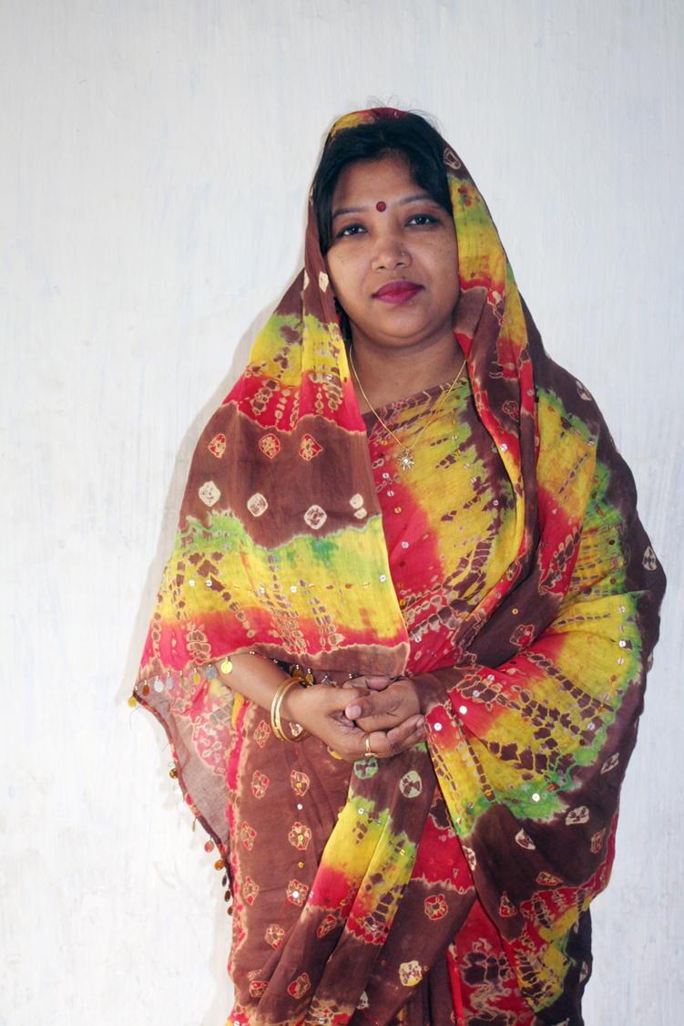

GOOD AFTERNOON
WELCOME TO GRAMMAR CLASS
CLASS Eight

Slide 3
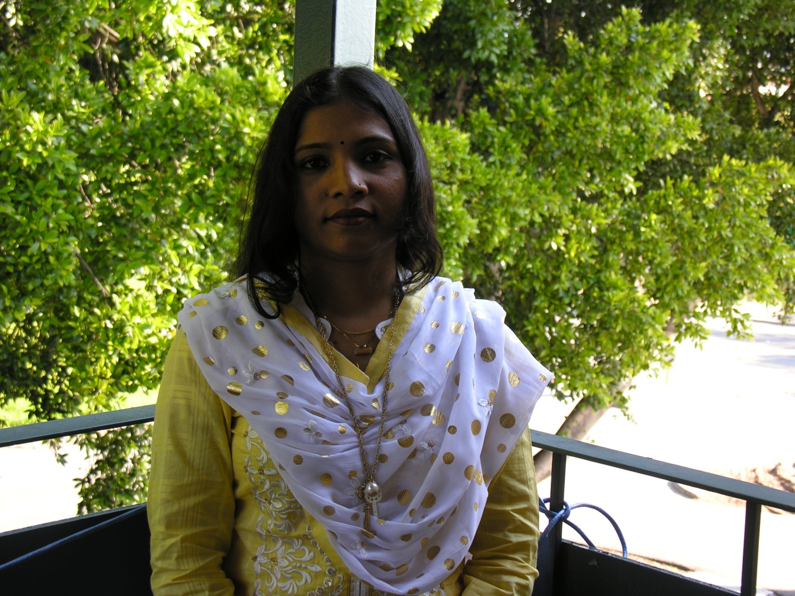
What can you see?
A picture of a girl
Nasrin is a pretty lady. She is standing beside a spreading apple tree. She is a debater, anchor , reciter and a rover. She lives in Australia with her husband, D. N. Alom and 2 year old daughter, Nisorgo . She is now doing P.H.D. She worked as a sub editor in The Daily Sabuj Sylhet in Bangladesh.

Slide 4

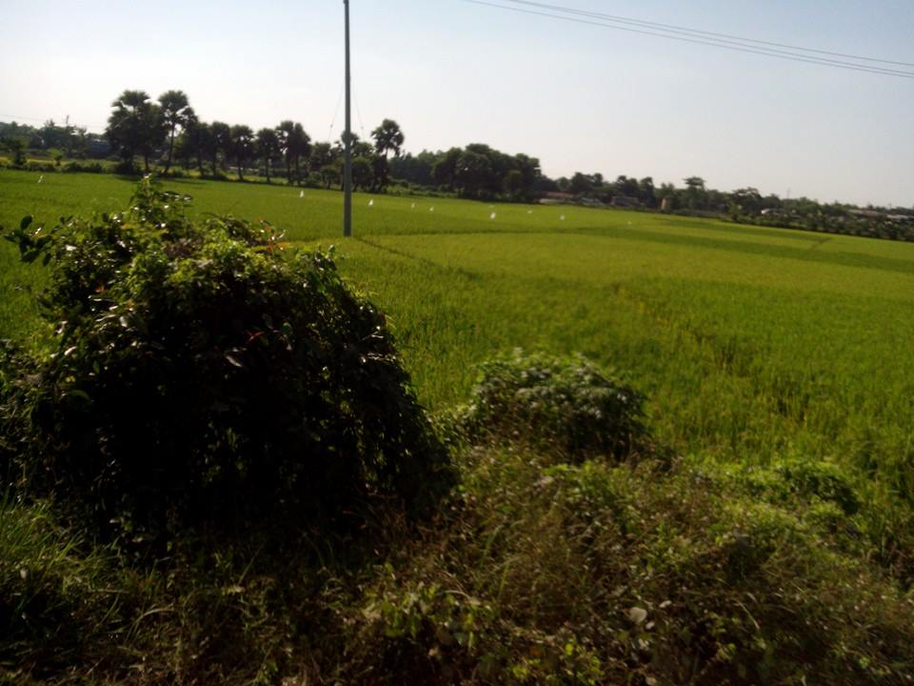
THE RULES OF CAPITALIZATION
B
angladesh
Bangladesh

Slide 5
Learning Outcomes:
After the end of the lesson the learners will be able to
write the name of any thing using the rules of capitalization
rewrite a passage using the rules of capitalization

Slide 6

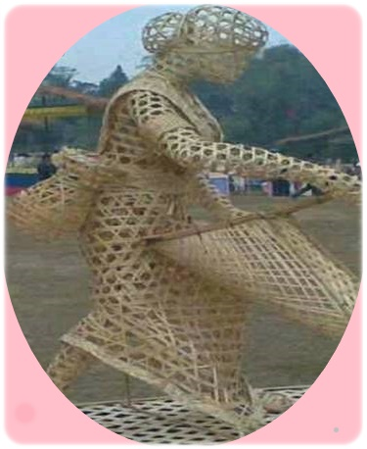
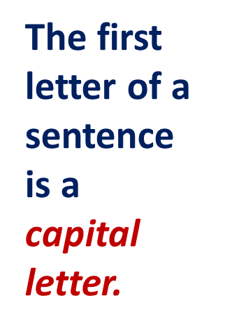
T
his is an outstanding artwork.

Slide 7
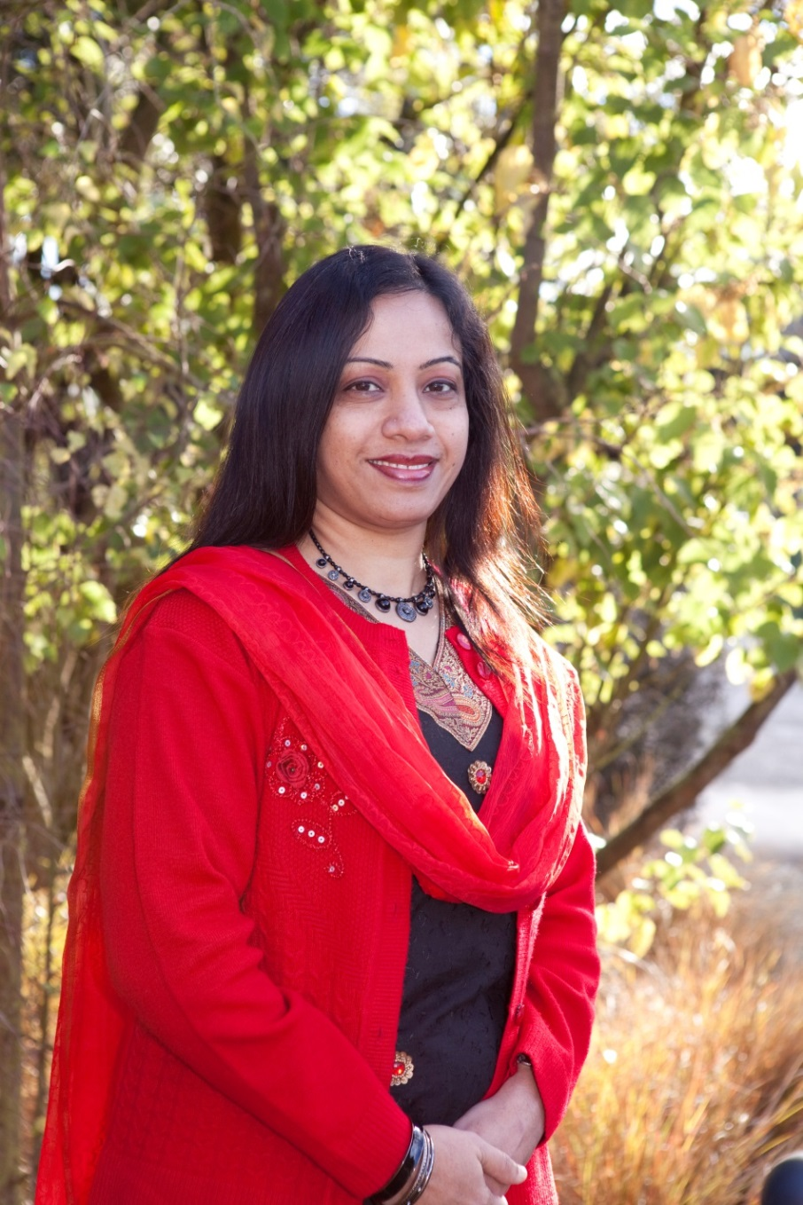
Ms.Nazma Parvin is an Associate Professor.
Proper noun
designation
A capital letter is used in case of the first letter of a
Proper noun .
The first letter of a is a capital letter.
designation

Slide 8
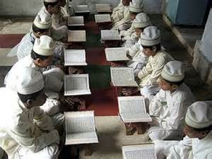
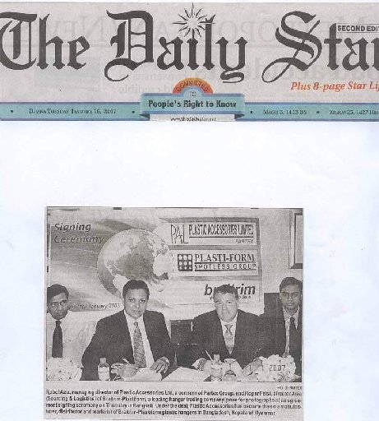
Children read the daily in the mosque.
Holy Quran
The first letter of the holy religious book is a capital letter
Daily Star
The publishes news
full of intrinsic value.
The first letter of a daily newspaper is a capital letter

Slide 9
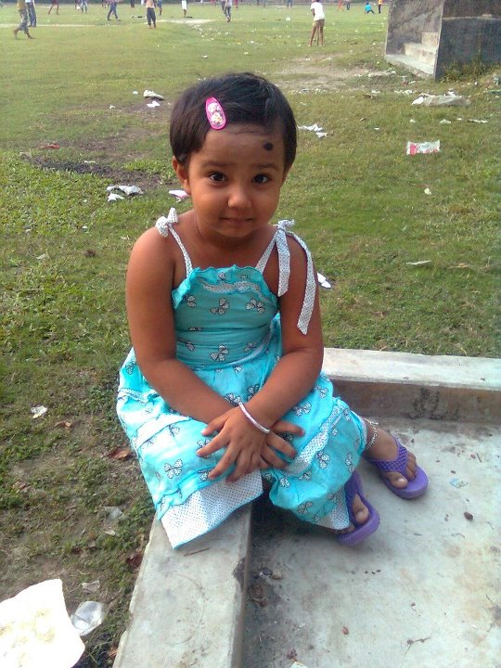
Mohona is a Bangladeshi child.
An adjective, created from a proper noun, takes a capital letter in the beginning.

Slide 10
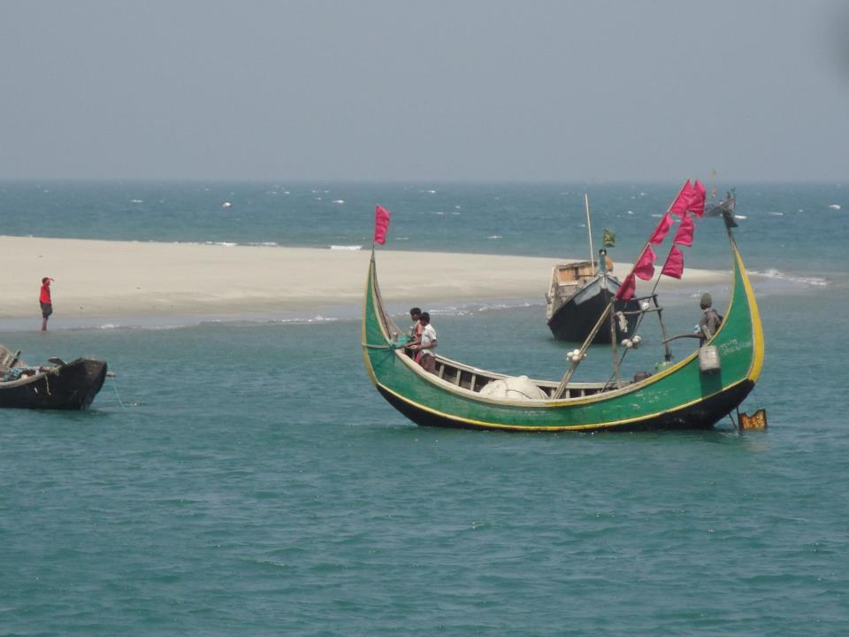

Padma
The is a big river.
The first letter of the name Of a river is a capital letter.
The first letter of the name Of a an ocean
is a capital letter.
The principal divisions of the ocean include the
Atlantic, Pacific, Indian, Arctic, Antarctic
oceans.

Slide 11
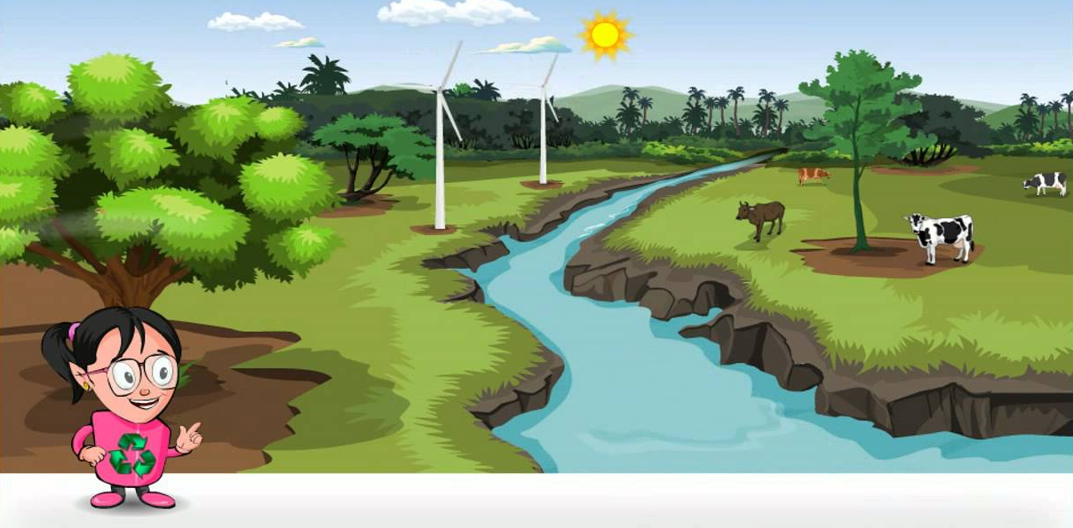
Rewrite the passage using the rules of capitalization where necessary..
I
C
T
M
A
A
S
S
T
R
in the picture, we see a river is flowing in a zigzag way. cattle are grazing in the nearby green field .the sun is shining brightly.ms ayesha amin is pointing to the river. she is in a smiling face. she will prepare a content for class six on “the rivers of bangladesh”.
B

Slide 12
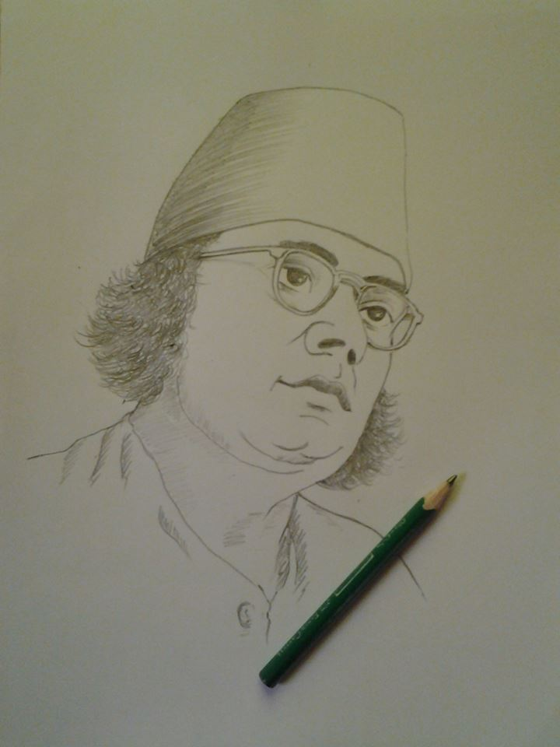
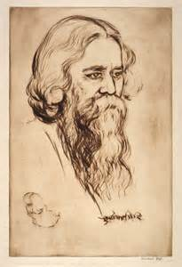
Group Work
Discuss the pictures within the groups . Now write 5 sentences about these pictures using the rules of capitalization . ( picture 1 for G-A & 2 for B ) .

Slide 13
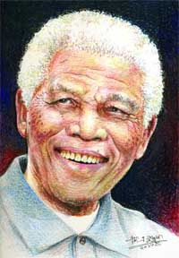
HOME WORK
Write 5 sentences about this given picture using the rules of capitalization.
Notes:
I’ll supply a picture among the learners each.

Slide 14



PREPARED &PRESENTED BY:
Dhanmondi, Dhaka-1207

Slide 15

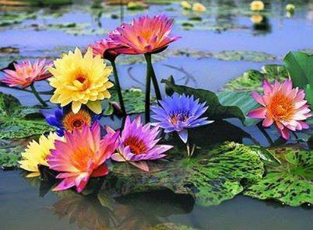

Slide 16
Acknowledgement
MoE, DSHE, NCTB & A2I respective officials
And the editors panel:
Mr. Ranjit Poddar, Associate Prof, TTC, Dhaka,
Mr. Md. Jahangir Hasan, Asst. Prof, TTC, Rangpur,
Urmila Khaled Asst. Prof, TTC, Dhaka.
Their direction, valuable suggestions and intensive supervision have enriched the model contents.

